Slide 1
RoBERTa: A Robustly Optimized BERT Pretraining Approach
https://www.cs.princeton.edu/~danqic/papers/roberta_paper.pdf

Slide 2
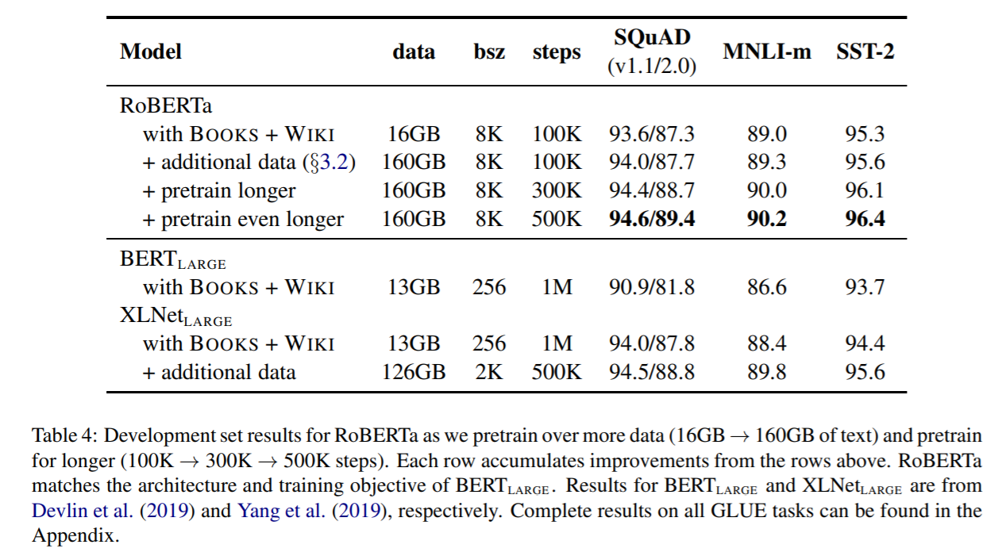
Improvement as to bert and final test result
In the previous section we propose modifications to the BERT pretraining procedure that improve end-task performance. We now aggregate these improvements and evaluate their combined impact. We call this configuration RoBERTa for Robustly optimized BERT approach. Specifically, RoBERTa is trained with dynamic masking (Section 4.1), FULL-SENTENCES without NSP loss (Section 4.2), large mini-batches (Section 4.3) and a larger byte-level BPE (Section 4.4). And with more data, more training steps, and get much better results compared with bert.

Slide 3
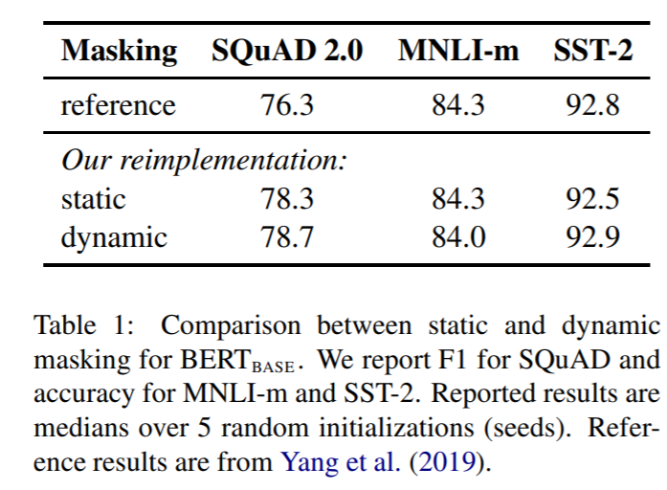
Dynamic masking
We compare this strategy with dynamic masking where we generate the masking pattern every time we feed a sequence to the model. This becomes crucial when pretraining for more steps or with larger datasets.

Slide 4
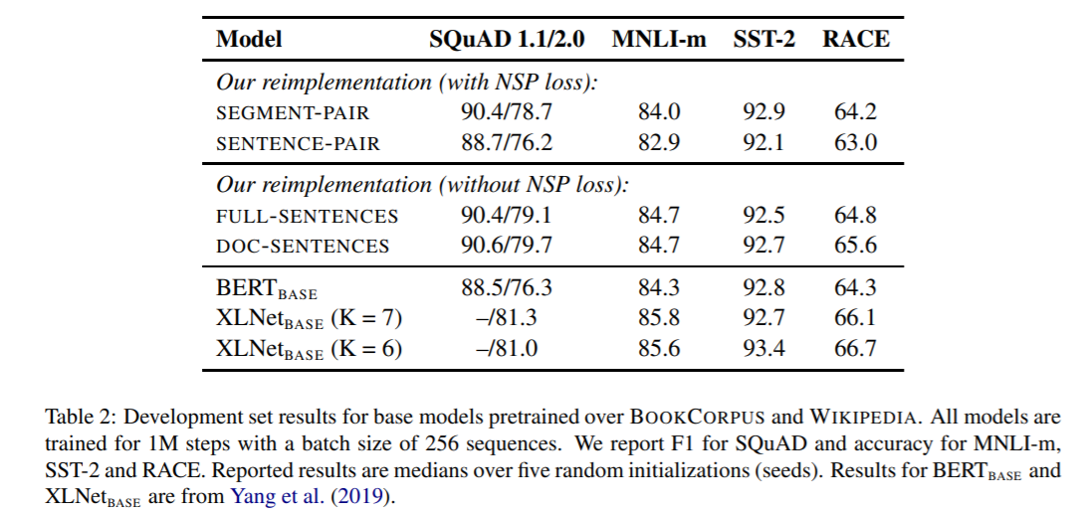
FULL-SENTENCES without NSP loss
Finally we find that restricting sequences to come from a single document (DOC-SENTENCES) performs slightly better than packing sequences from multiple documents (FULL-SENTENCES). However, because the DOC-SENTENCES format results in variable batch sizes, we use FULLSENTENCES in the remainder of our experiments for easier comparison with related work.

Slide 5
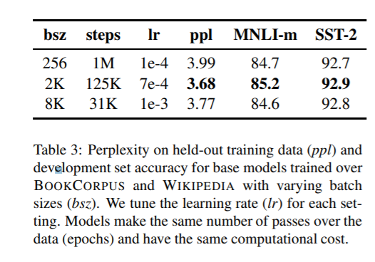
Large mini-batches
We observe that training with large batches improves perplexity for the masked language modeling objective, as well as end-task accuracy. Large batches are also easier to parallelize via distributed data parallel training,8 and in later experiments we train with batches of 8K sequences.

Slide 6
Byte-level BPE
BPE vocabulary sizes typically range from 10K-100K subword units. However, unicode characters can account for a sizeable portion of this vocabulary when modeling large and diverse corpora, such as the ones considered in this work. Radford et al. (2019) introduce a clever implementation of BPE that uses bytes instead of unicode characters as the base subword units. Using bytes makes it possible to learn a subword vocabulary of a modest size (50K units) that can still encode any input text without introducing any “unknown” tokens
The original BERT implementation (Devlin et al., 2019) uses a character-level BPE vocabulary of size 30K, which is learned after preprocessing the input with heuristic tokenization rules. Following Radford et al. (2019), we instead consider training BERT with a larger byte-level BPE vocabulary containing 50K subword units, without any additional preprocessing or tokenization of the input.

Slide 7
Conclusion
We carefully evaluate a number of design decisions when pretraining BERT models. We find that performance can be substantially improved by training the model longer, with bigger batches over more data; removing the next sentence prediction objective; training on longer sequences; and dynamically changing the masking pattern applied to the training data. Our improved pretraining procedure, which we call RoBERTa, achieves state-of-the-art results on GLUE, RACE and SQuAD, without multi-task finetuning for GLUE or additional data for SQuAD. These results illustrate the importance of these previously overlooked design decisions and suggest that BERT’s pretraining objective remains competitive with recently proposed alternatives.

